Slide 1
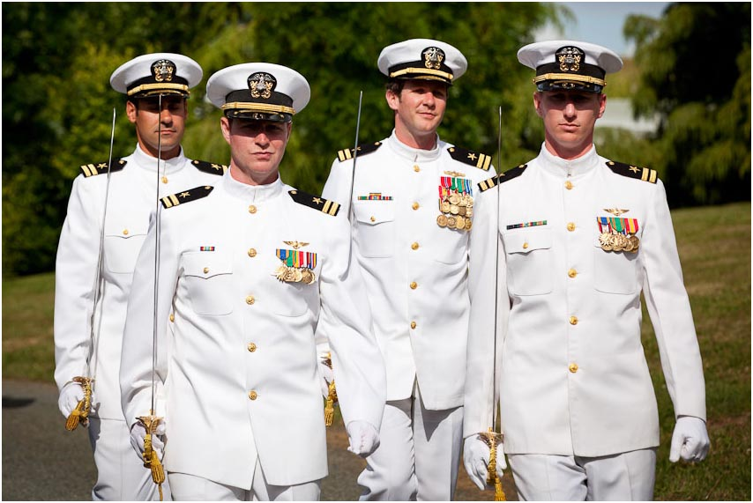

Slide 2
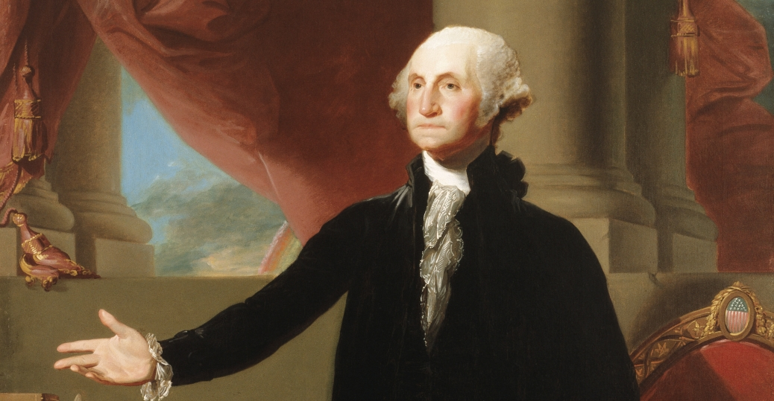

Slide 3


Slide 4
I. Love
A) Salute – 1 Peter 5:14
B) Serve – Galatians 5:13
C) Share – Romans 12:10

Slide 5


Slide 6
Humility
A) Denial – Romans 12:10; Philippians 2:3
B) Dedication – Ephesians 5:21
C) Devotion – John 13:14

Slide 7


Slide 8
Unity
A) Peace – Mark 9:50; Philippians 2:3
B) Patience – Ephesians 4:2, 32
C) Perseverance – James 4:11; 5:9, 16

Slide 9


