Slide 1
DISTRACTED

Slide 3
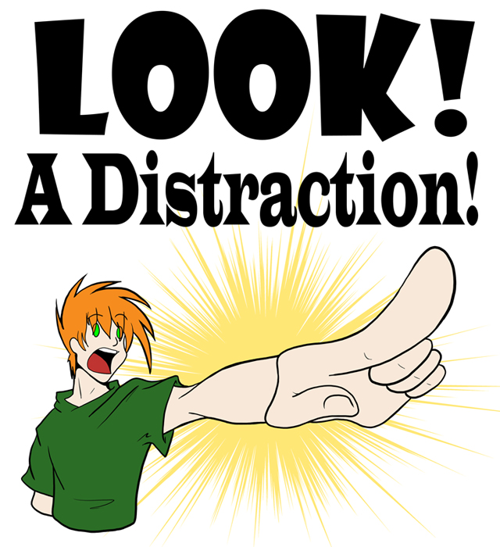
Technology
Work
Recreation
Relationships
Turmoil
Struggles
Apathy

