Slide 2


Slide 3
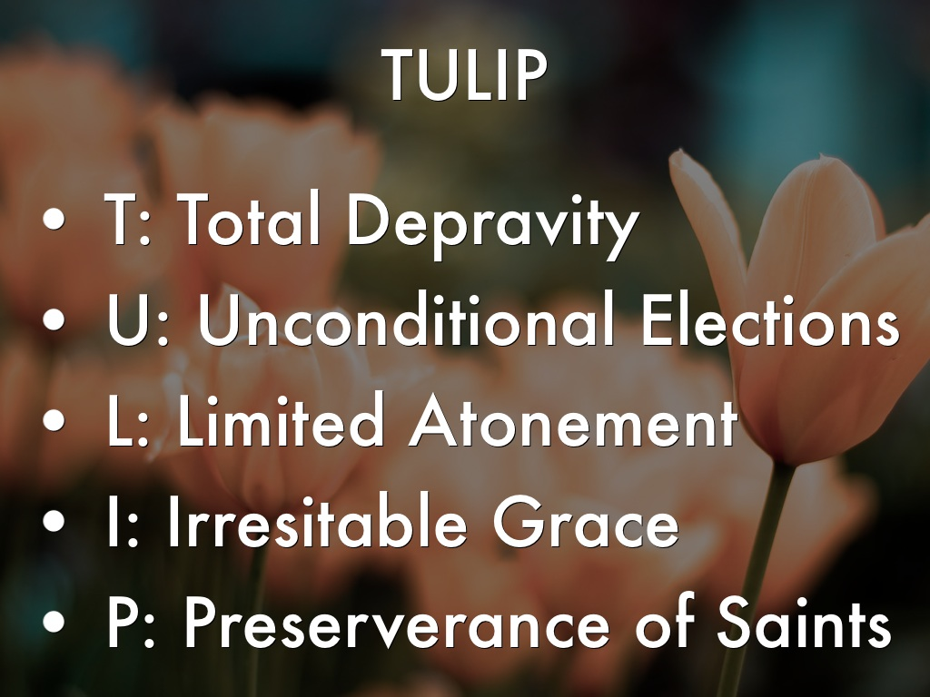

Slide 4
TULIP
T - Total Depravity
U - Unconditional Elections
L - Limited Atonement
I - Irresistible Grace
P - Perseverance of Saints

Slide 5
