Slide 4
Blind Faith?!

Slide 5
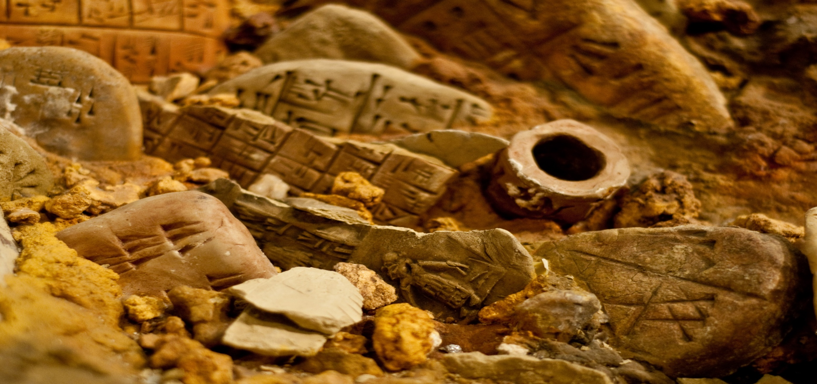
Archaeology

Slide 6
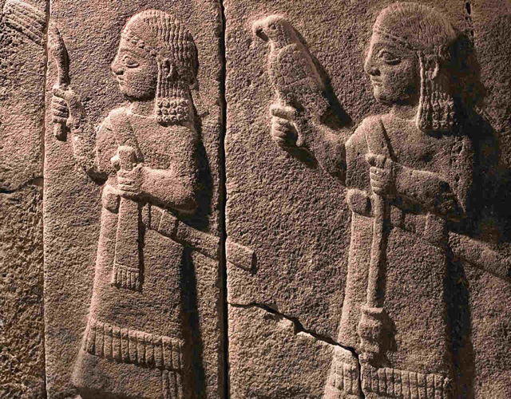
The Hittites

Slide 7
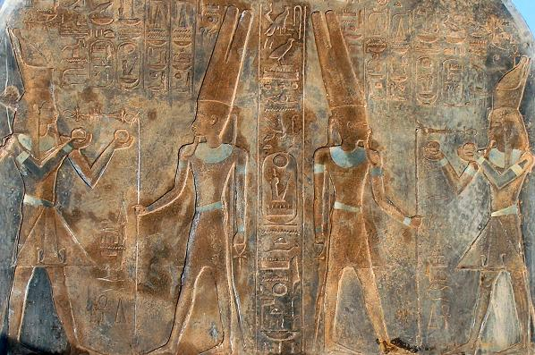
Merneptah Stele

Slide 8
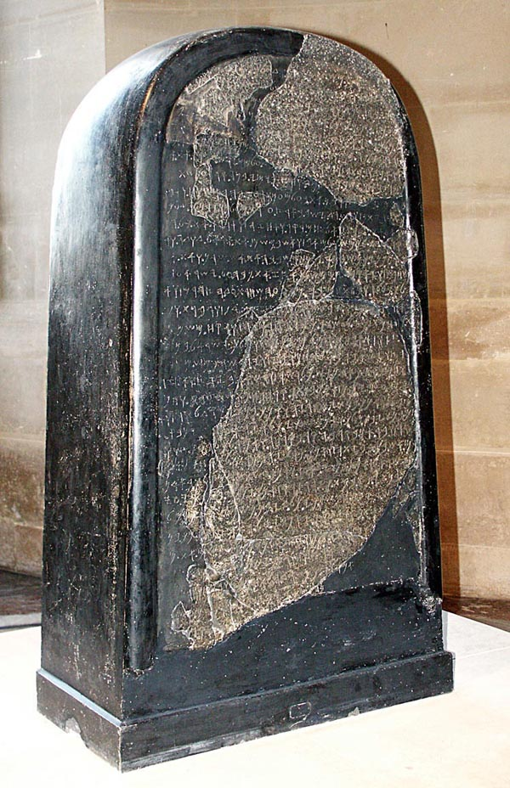
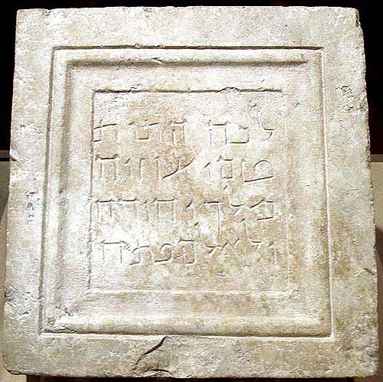

Slide 9
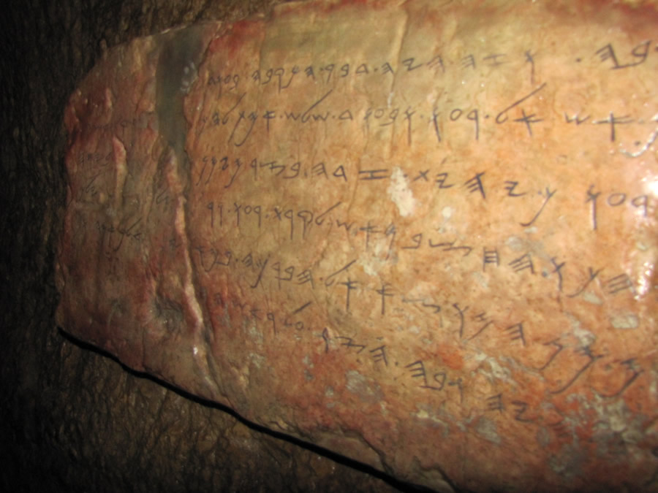
Siloam
Inscription

Slide 10
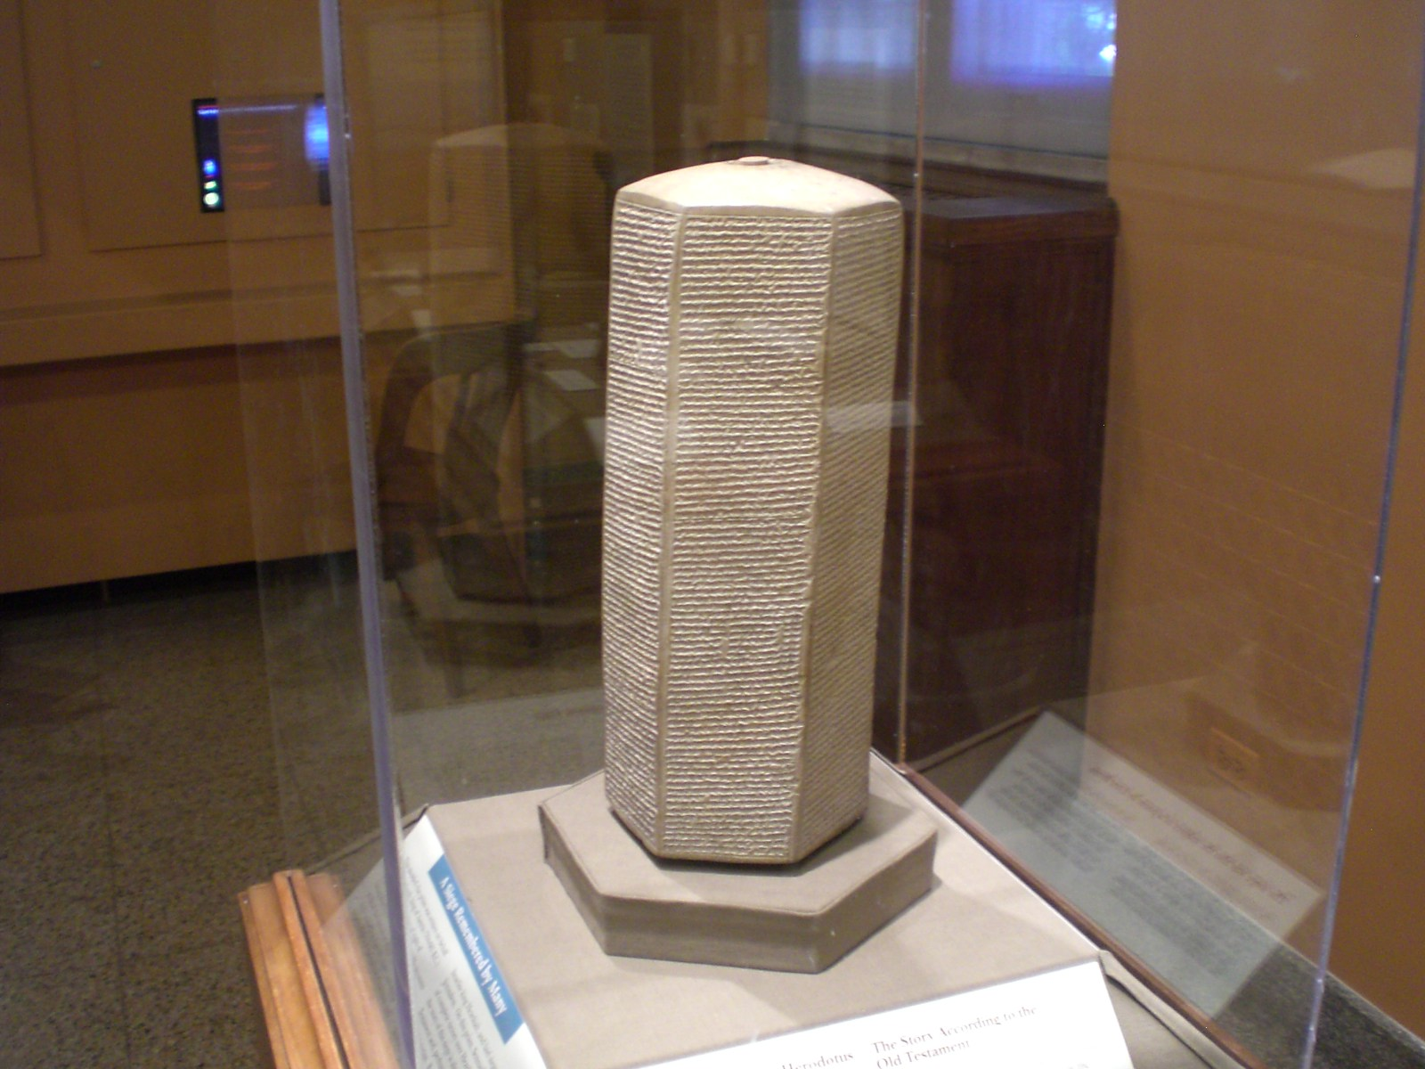

Slide 11
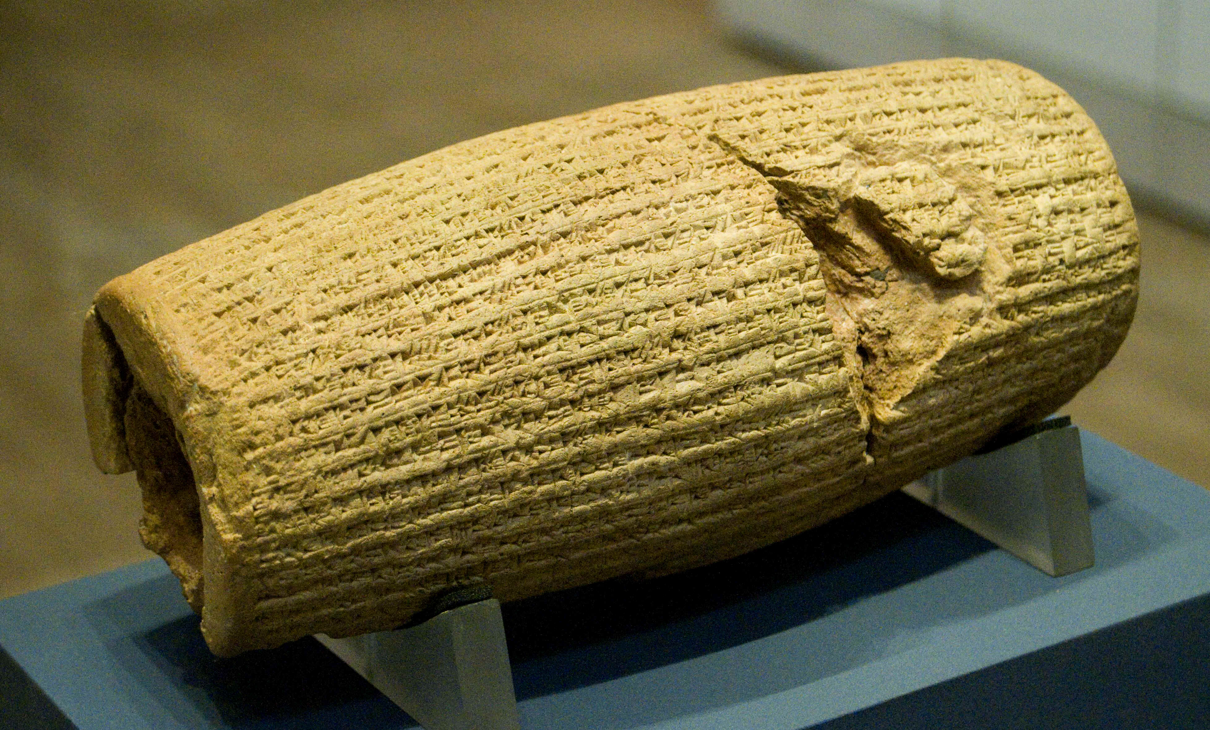
Cylinder of Cyrus the Great

Slide 12
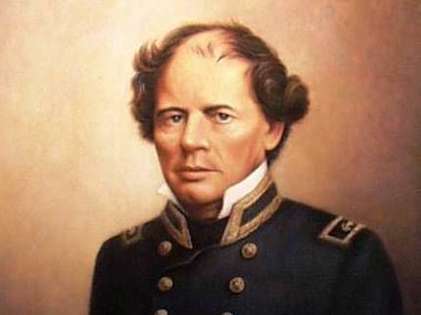
Psalm 8:8

Slide 13
Science

Slide 14
“We are, by astronomical standards, a pampered, cherished group of creatures…If the universe had not been made with the most exacting precision we could have never come into existence. It is my view that these circumstances indicate the universe was created for man to live in.”
- NASA Astronomer John O’Keefe

Slide 15
”One cannot be exposed to the law and order of the universe without concluding that there must be a design and purpose behind it all...The better we understand the intricacies of the universe...the more reason we have found to marvel at the inherent design upon which it is based...To be forced to believe only one conclusion - that everything in the universe happened by chance - would violate the very objectivity of science itself...

Slide 16
What random process could produce the brains of a man or the system of the human eye?...They [evolutionists] challenge science to prove the existence of God. But must we really light a candle to see the sun?...They say they cannot visualize a designer. Well, can a physicist visualize an electron? What strange rationale makes some physicists accept the inconceivable electron as real, while refusing to accept the reality of a designer on the ground that they cannot conceive Him?”
- Wernher von Braun
(father of the American Space Program)

Slide 18
Flavius Josephus (A.D. 37/38 – A.D. 100)
“And there arose about this time Jesus, a wise man, if indeed we should call him a man; for he was a doer of marvelous deeds, a teacher of men who receive the truth with pleasure. He led away many Jews, and also Greeks. This man was the Christ. And when Pilate had condemned him to the cross

Slide 19
on his impeachment by the chief men among us, those who had loved him at first did not cease; for he appeared to them on the third day alive again, the divine prophets having spoken these and thousands of other wonderful things about him: and even now the tribe of Christians, so named after him, has not yet died out.”

Slide 20
Cornelius Tacitus (A.D. 55 – A.D. 117)
“Consequently, to get rid of the report, Nero fastened the guilt and inflicted the most exquisite tortures on a class hated for their abominations, called Christians by the populace. Christus, from whom the name had its origin, suffered the extreme penalty during the reign of Tiberius at the hands of one of our procurators, Pontius Pilatus, and a most mischievous superstition, thus checked for the moment, again broke out, not only in Judea, the first source of the evil, but even in Rome, where all things hideous and shameful from every part of the world find their center and become popular.

Slide 21
Accordingly, an arrest was first made of all who pleaded guilty; then, upon their information, an immense multitude was convicted, not so much of the crime of firing the city, as of hatred against mankind. Mockery of every sort was added to their deaths. Covered with the skins of beasts, they were torn by dogs and perished, or were nailed to crosses, or were doomed to the flames and burnt, to serve as a nightly illumination, when daylight had expired.”

Slide 22
Seutonius
“Because the Jews at Rome caused continuous disturbance at the instigation of Christos, he (Claudius) expelled them from the city.”
The Twelve Caesars (A.D. 120)
(Acts 18:2)

Slide 23
Lucian
“The Christians, you know, worship a man to this day – the distinguished personage who introduced their novel rites, and was crucified on that account…You see, these misguided creatures start with the general conviction that they are immortal for all time, which explains the contempt of death and voluntary self-devotion which are so common among them; and then it was impressed on them by their original lawgiver that they are all brothers, from the moment that they are converted, and deny the gods of Greece, and worship the crucified sage, and live after his laws.”

Slide 24
Governor Pliny the Younger
“…those who professed Christianity affirmed, however, that the whole of their guilt, or their error, was that they were in the habit of meeting on a certain fixed day before it was light, when they sang in alternate verses a hymn to Christ, as to a god, and bound themselves by solid oath, not to any wicked deeds.”

Slide 25
Psalm 1

